Slide 1
Cryptanalysis of LEDAcrypt
Daniel Apon¹, Ray Perlner¹, Angela Robinson¹, Paolo Santini²
1: NIST
2: Università Politecnica delle Marche, Florida Atlantic University

Slide 2
Significance
We present an attack on the QC-LDPC-McEliece construction of
[Baldi et al. 2007]
This construction was the basis of the second-round NIST PQC candidate, LEDAcrypt
Prior to our attack this construction had a nearly 12-year history without a major break
Our attack was a major factor in the non-selection of LEDAcrypt for the third round of the NIST PQC process
  In response, the LEDAcrypt team published an updated spec which avoided the attack
  NIST ultimately decided that this updated spec represented too large a tweak and made LEDAcrypt too similar to its competitor BIKE
  (BIKE is based on the QC-MDPC-McEliece scheme of [Misoczki et al. 2012])

Slide 3
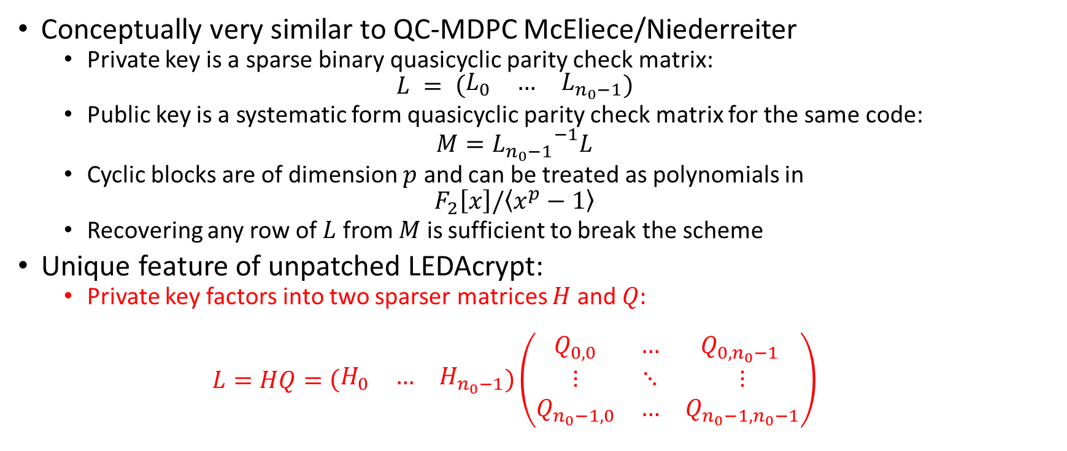
LEDAcrypt Overview
Conceptually very similar to QC-MDPC McEliece/Niederreiter
  Private key is a sparse binary quasicyclic parity check matrix:
  $$L = \left(\begin{matrix}L_{0} & … & L_{n_{0}−1}\end{matrix}\right)$$
  Public key is a systematic form quasicyclic parity check matrix for the same code:
  $$M={L_{n_{0}−1}}^{−1}L$$
  Cyclic blocks are of dimension $p$ and can be treated as polynomials in
  $$F_{2}\left[x\right]/\left\langle x^{p}−1\right\rangle$$
  Recovering any row of $L$ from $M$ is sufficient to break the scheme
Unique feature of unpatched LEDAcrypt:
  Private key factors into two sparser matrices $H$ and $Q:$
  $$L=HQ=\left(\begin{matrix}H_{0} & … & H_{n_{0}−1}\end{matrix}\right)\left(\begin{matrix}Q_{0,0} & … & Q_{0,n_{0}−1} \\ ⋮ & ⋱ & ⋮ \\ Q_{n_{0}−1,0} & … & Q_{n_{0}−1,n_{0}−1}\end{matrix}\right)$$

Slide 4
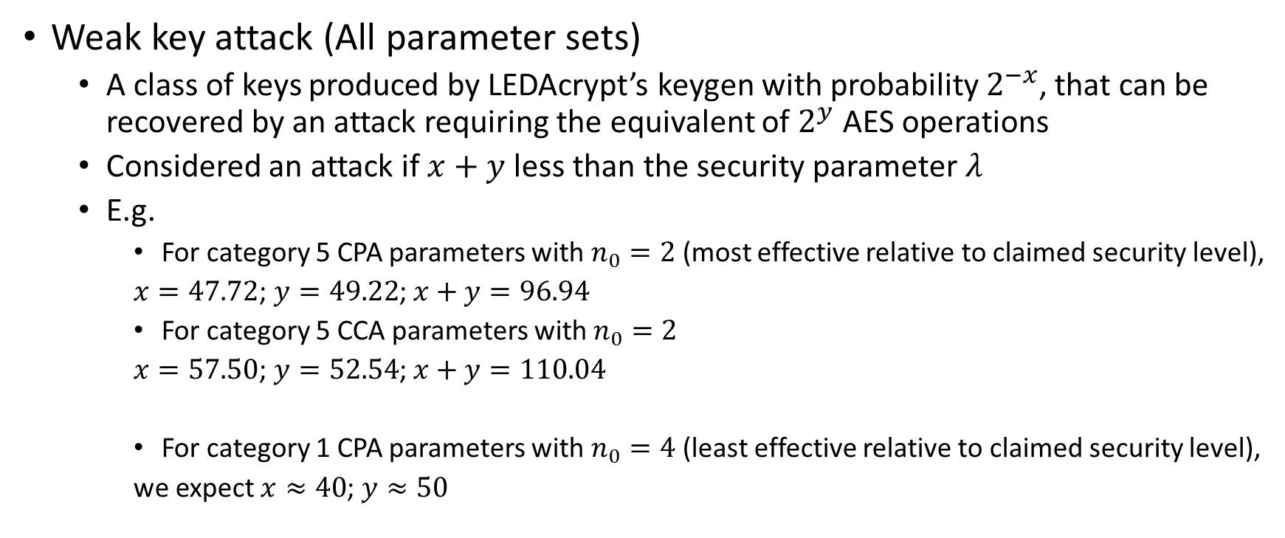
Summary of Attacks
Weak key attack (All parameter sets)
  A class of keys produced by LEDAcrypt’s keygen with probability $2^{−x}$, that can be recovered by an attack requiring the equivalent of $2^{y}$ AES operations
  Considered an attack if $x+y$ less than the security parameter $λ$
  E.g.
    For category 5 CPA parameters with $n_{0}=2$ (most effective relative to claimed security level),
    $x=47.72$; $y=49.22$; $x+y=96.94$
    For category 5 CCA parameters with $n_{0}=2$
    $x=57.50$; $y=52.54$; $x+y=110.04$
    For category 1 CPA parameters with $n_{0}=4$ (least effective relative to claimed security level),
    we expect $x≈40$; $y≈50$

Slide 5
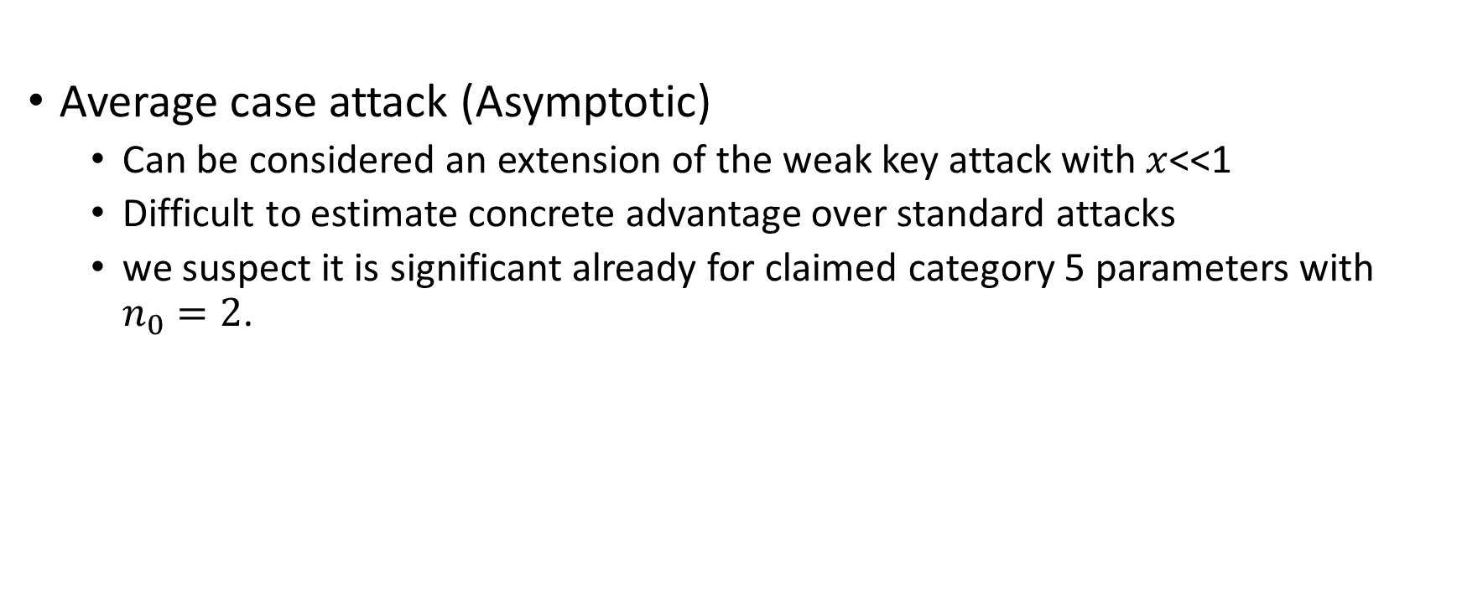
Summary of Attacks Cont.
Average case attack (Asymptotic)
  Can be considered an extension of the weak key attack with $x$<<1
  Difficult to estimate concrete advantage over standard attacks
  we suspect it is significant already for claimed category 5 parameters with $n_{0}=2$.

Slide 6
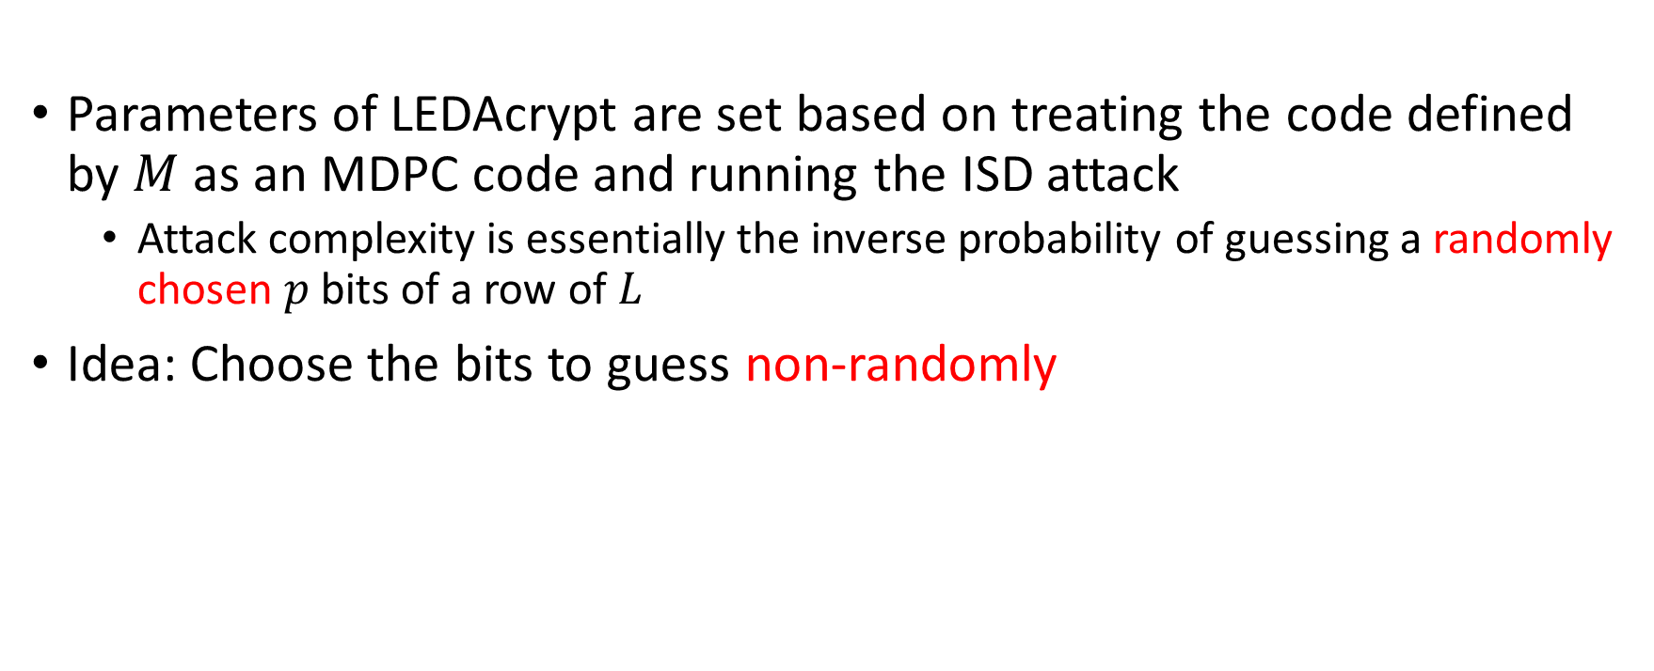
Using LEDAcrypt’s Product Structure
Basic Idea
Parameters of LEDAcrypt are set based on treating the code defined by $M$ as an MDPC code and running the ISD attack
  Attack complexity is essentially the inverse probability of guessing a randomly chosen $p$ bits of a row of $L$
Idea: Choose the bits to guess non-randomly

Slide 7
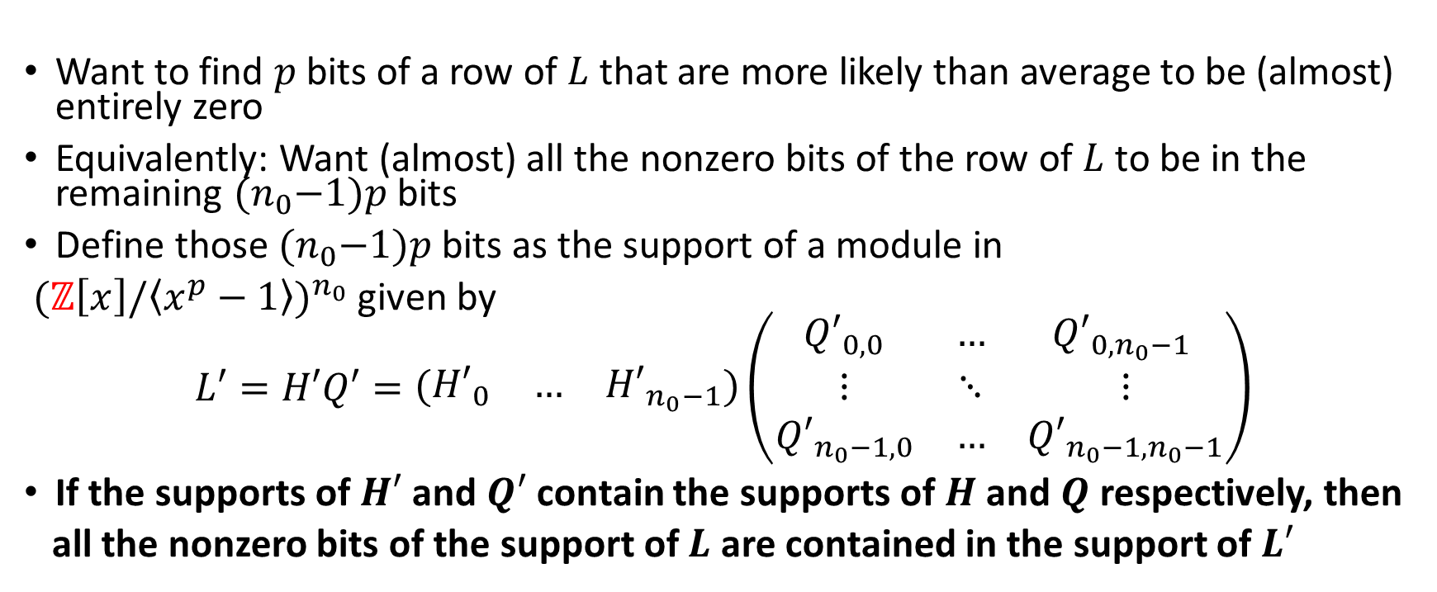
Using LEDAcrypt’s Product Structure
Choosing the Bits to Guess
Want to find $p$ bits of a row of $L$ that are more likely than average to be (almost) entirely zero
Equivalently: Want (almost) all the nonzero bits of the row of $L$ to be in the remaining ${(n}_{0}−1)p$ bits
Define those ${(n}_{0}−1)p$ bits as the support of a module in
${(ℤ\left[x\right]/\left\langle x^{p}−1\right\rangle )}^{n_{0}}$ given by
$$L′=H′Q′=\left(\begin{matrix}{H′}_{0} & … & {H′}_{n_{0}−1}\end{matrix}\right)\left(\begin{matrix}{Q′}_{0,0} & … & {Q′}_{0,n_{0}−1} \\ ⋮ & ⋱ & ⋮ \\ {Q′}_{n_{0}−1,0} & … & {Q′}_{n_{0}−1,n_{0}−1}\end{matrix}\right)$$
If the supports of $H′$ and $Q′$ contain the supports of $H$ and $Q$ respectively, then
all the nonzero bits of the support of $L$ are contained in the support of $L′$

Slide 8
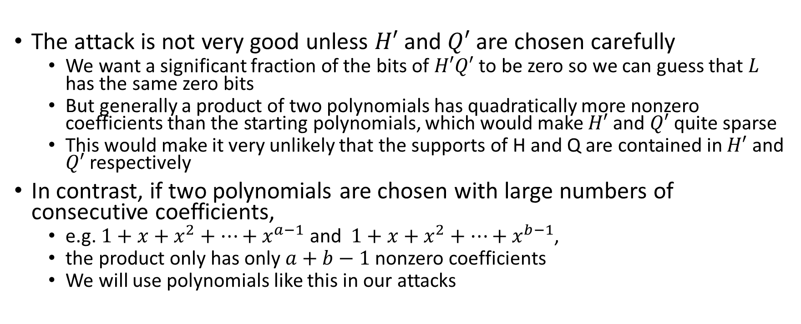
Contiguous Nonzero Coefficients
The attack is not very good unless $H′$ and $Q′$ are chosen carefully
  We want a significant fraction of the bits of $H′Q′$ to be zero so we can guess that $L$ has the same zero bits
  But generally a product of two polynomials has quadratically more nonzero coefficients than the starting polynomials, which would make $H′$ and $Q′$ quite sparse
  This would make it very unlikely that the supports of H and Q are contained in $H′$ and $Q′$ respectively
In contrast, if two polynomials are chosen with large numbers of consecutive coefficients,
  e.g. $1+x+x^{2}+…+x^{a−1}$ and $1+x+x^{2}+…+x^{b−1}$,
  the product only has only $a+b−1$ nonzero coefficients
  We will use polynomials like this in our attacks

Slide 9
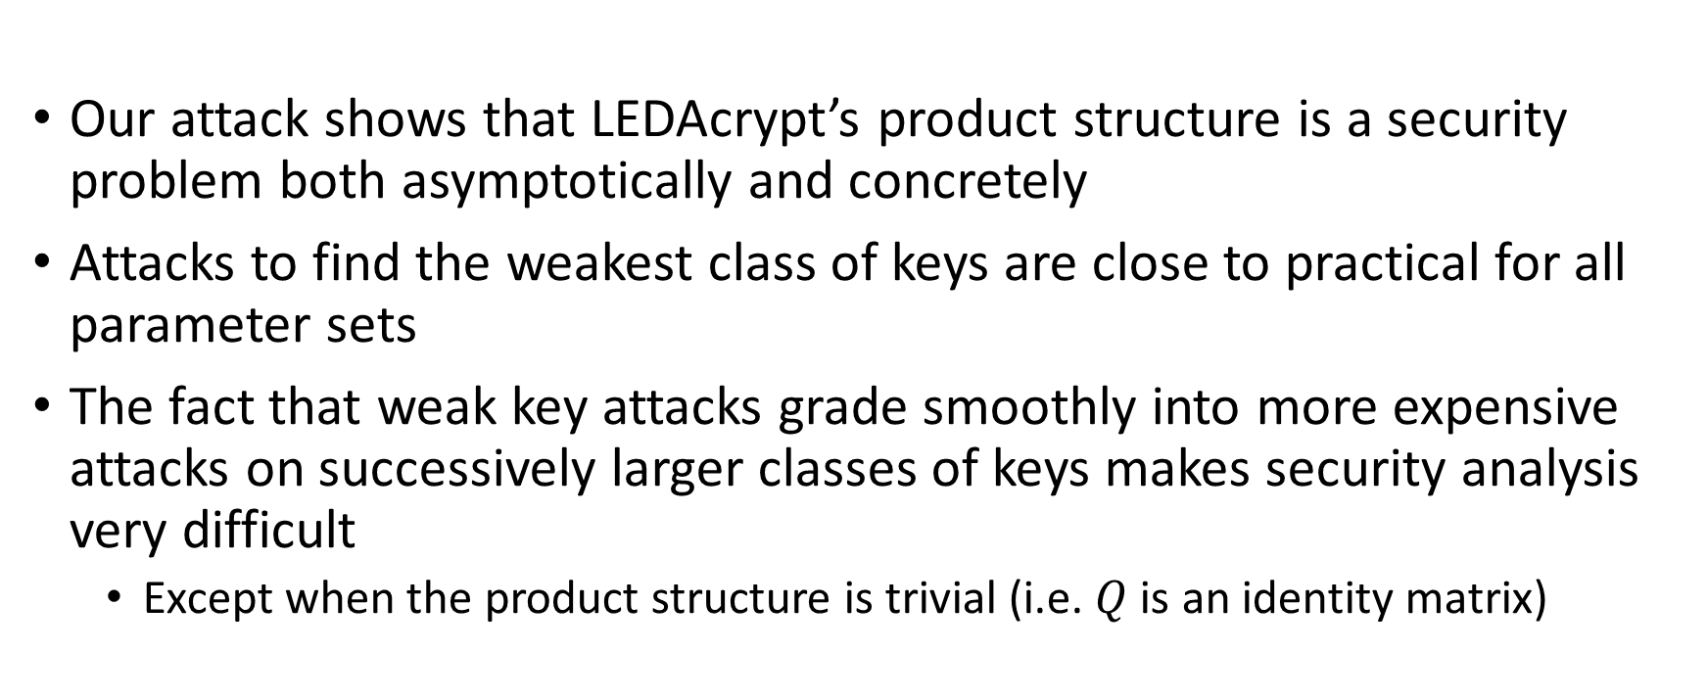
Conclusion
Our attack shows that LEDAcrypt’s product structure is a security problem both asymptotically and concretely
Attacks to find the weakest class of keys are close to practical for all parameter sets
The fact that weak key attacks grade smoothly into more expensive attacks on successively larger classes of keys makes security analysis very difficult
  Except when the product structure is trivial (i.e. $Q$ is an identity matrix)

